Slide 1

ECE 382V: QUANTUM COMPUTING SYSTEMS:
A SOFTWARE/ ARCHITECTURE PERSPECTIVE
Linear Algebra, Quantum Gates, And Circuits
Why quantum computing? What topics will be covered? What are the requirements and expected outcomes?
POULAMI DAS
ECE, The University of Texas at Austin

Slide 2

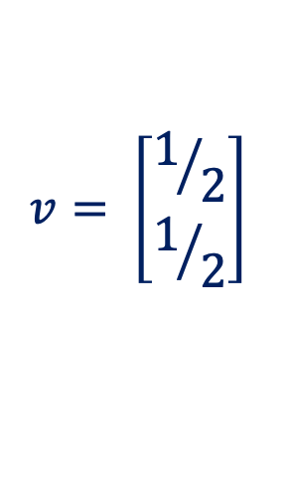
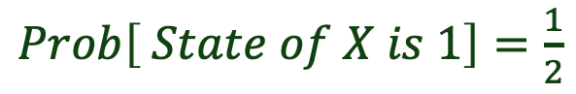
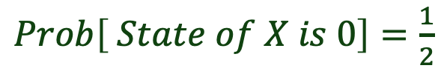
Vector Representation Of Probabilistic Outcomes
$Prob\left[ State of X is 0\right]=\frac{1}{2}$
Flipping an Unbiased Coin (X):
Representing Heads (0) and Tails (1)
$Prob\left[ State of X is 1\right]=\frac{1}{2}$
Mathematically, we can write
this as “probability vector”
$$v= \left[\begin{matrix}1/2 \\ 1/2\end{matrix}\right]$$
Entry indexed by 0
Entry indexed by 1
Requirement: The sum of all the entries in the column (L1-norm) must add up to 1
A qubit may be represented using a complex vector

Slide 3
Recap: Classical Logic Gates Using Truth Tables
The truth table specifies the transformation of the classical states using a logic gate

Slide 4

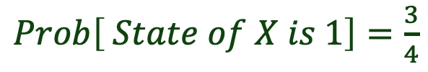
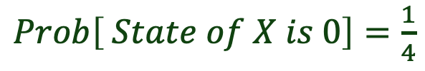
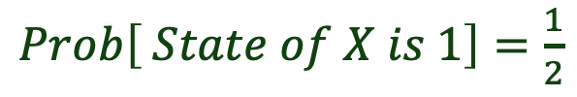
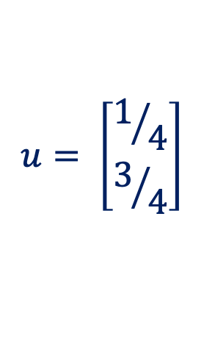
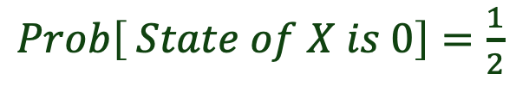


Impact Of Quantum Gates: Change Probability Amplitude
Unbiased
Biased
$$v= \left[\begin{matrix}1/2 \\ 1/2\end{matrix}\right]$$
Quantum
Gate (G)
$$u= \left[\begin{matrix}1/4 \\ 3/4\end{matrix}\right]$$
$$v=Gu$$
$Prob\left[ State of X is 0\right]=\frac{1}{2}$
$Prob\left[ State of X is 0\right]=\frac{1}{4}$
$Prob\left[ State of X is 1\right]=\frac{1}{2}$
$Prob\left[ State of X is 1\right]=\frac{3}{4}$
Quantum operations modify the probability amplitudes of the quantum states

Slide 5



Impact Of Measurement (Resolution Of Coin Toss)
Unbiased
T
H
H
T
H
$$w=0$$
25%
Biased
$$u= \left[\begin{matrix}1/4 \\ 3/4\end{matrix}\right]$$
75%
T
$$w=1$$
T
T
H
T
Qubit measurement operation is destructive and produces classical outcome

Slide 6
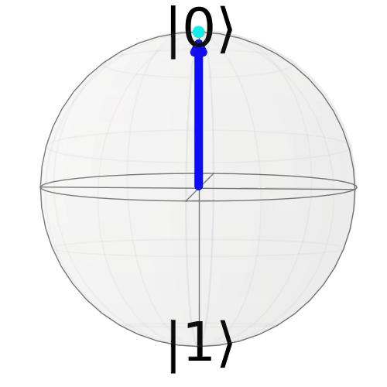
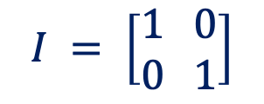
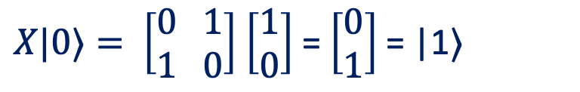
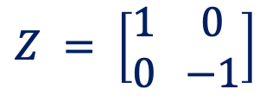
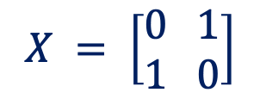
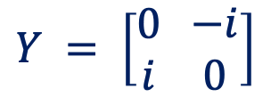
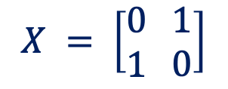
Quantum Operations As Matrices
Example:
$$X = \left[\begin{matrix}0 \\ 1\end{matrix} \begin{matrix}1 \\ 0\end{matrix}\right]$$
$X|0⟩= \left[\begin{matrix}0 \\ 1\end{matrix} \begin{matrix}1 \\ 0\end{matrix}\right]$ $\left[\begin{matrix}1 \\ 0\end{matrix}\right]$ = $\left[\begin{matrix}0 \\ 1\end{matrix}\right]$= |1〉
X
State 0
State 1
Bit-flip/NOT
$$X = \left[\begin{matrix}0 \\ 1\end{matrix} \begin{matrix}1 \\ 0\end{matrix}\right]$$
$$Y = \left[\begin{matrix}0 \\ i\end{matrix} \begin{matrix}−i \\ 0\end{matrix}\right]$$
$$Z = \left[\begin{matrix}1 \\ 0\end{matrix} \begin{matrix}0 \\ −1\end{matrix}\right]$$
$$I = \left[\begin{matrix}1 \\ 0\end{matrix} \begin{matrix}0 \\ 1\end{matrix}\right]$$
Bit-flip
Phase-flip
Bit-flip & Phase-flip
Identity
The X,Y,Z, and I operations are collectively called the Pauli operations

Slide 7
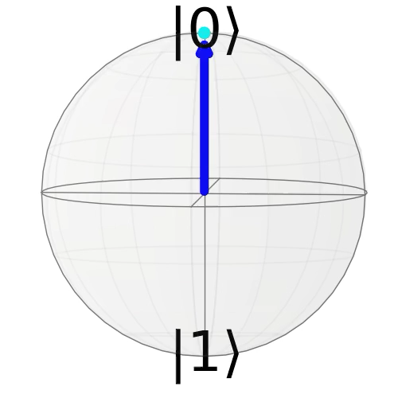
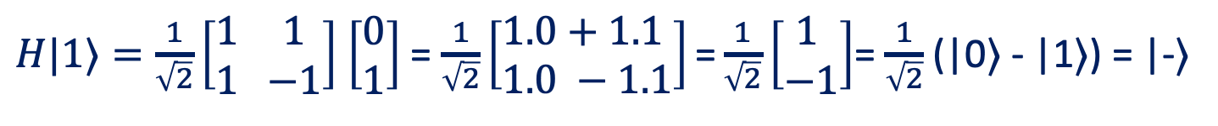
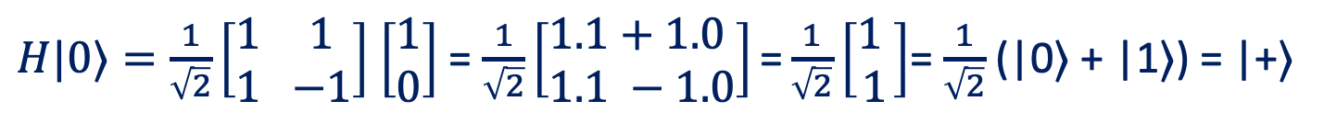
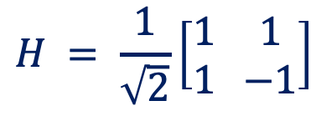
Hadamard Gate
$$H = \frac{1}{\sqrt{2}}\left[\begin{matrix}1 \\ 1\end{matrix} \begin{matrix}1 \\ −1\end{matrix}\right]$$
H
Superposition
Example:
$H|0⟩=\frac{1}{\sqrt{2}}\left[\begin{matrix}1 \\ 1\end{matrix} \begin{matrix}1 \\ −1\end{matrix}\right]$ $\left[\begin{matrix}1 \\ 0\end{matrix}\right]$ = $\frac{1}{\sqrt{2}}\left[\begin{matrix}1.1+1.0 \\ 1.1 −1.0\end{matrix}\right]\text{=}\frac{1}{\sqrt{2}}\left[\begin{matrix}1 \\ 1\end{matrix}\right]$= $\frac{1}{\sqrt{2}}$(|0〉 + |1〉) = |+〉
$H|1⟩=\frac{1}{\sqrt{2}}\left[\begin{matrix}1 \\ 1\end{matrix} \begin{matrix}1 \\ −1\end{matrix}\right]$ $\left[\begin{matrix}0 \\ 1\end{matrix}\right]$ = $\frac{1}{\sqrt{2}}\left[\begin{matrix}1.0+1.1 \\ 1.0 −1.1\end{matrix}\right]\text{=}\frac{1}{\sqrt{2}}\left[\begin{matrix}1 \\ −1\end{matrix}\right]$= $\frac{1}{\sqrt{2}}$(|0〉 - |1〉) = |-〉
What happens if you apply the Hadamard gate to the |+〉 and |-〉 states?

Slide 8

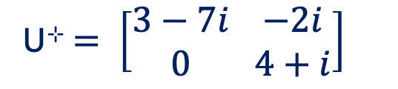
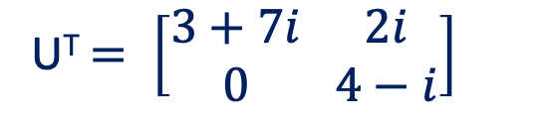
Requirement: Operation Matrices Must Be Unitary
If U is the operation matrix and U⊹ denotes the conjugate transpose of U, then U ⊹U = I
Conjugate transpose U⊹ : Compute the transpose of U and then the complex conjugate of each individual entries
Example:
U$= \left[\begin{matrix}3+7i \\ 2i\end{matrix} \begin{matrix}0 \\ 4−i\end{matrix}\right]$
U^{T}$= \left[\begin{matrix}3+7i \\ 0\end{matrix} \begin{matrix}2i \\ 4−i\end{matrix}\right]$
U⊹$= \left[\begin{matrix}3−7i \\ 0\end{matrix} \begin{matrix}−2i \\ 4+i\end{matrix}\right]$
Given Matrix
Transpose
Conjugate Transpose
How about multi-qubit systems?

Slide 9


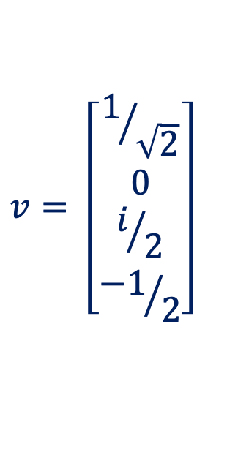
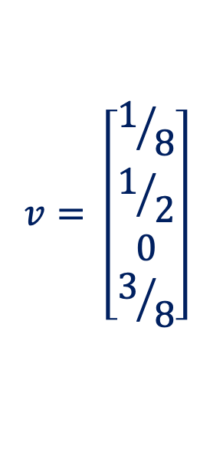
Representation Of Two-Qubit Systems
Flipping 2 coins (X and Y):
Valid or not?
$$v= \left[\begin{matrix}1/8 \\ \begin{aligned}1/2 \\ 0 \\ 3/8\end{aligned}\end{matrix}\right]$$
$$v= \left[\begin{matrix}1/{\sqrt{2}} \\ \begin{aligned}0 \\ i/2 \\ {−1}/2\end{aligned}\end{matrix}\right]$$
Probability associated with state 00
Probability associated with state 01
Probability associated with state 10
Probability associated with state 11
❘ ψ ₂ ψ ₁ 〉= ⍺₀₀❘00〉+ ⍺₀₁❘01〉+ ⍺₁₀❘10〉+ ⍺₁₁❘11〉
Requirement: The L2-norm of the column must be 1
What about operations on multiple qubits?

Slide 10
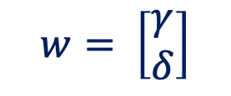
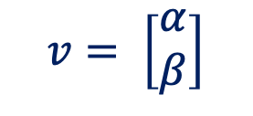
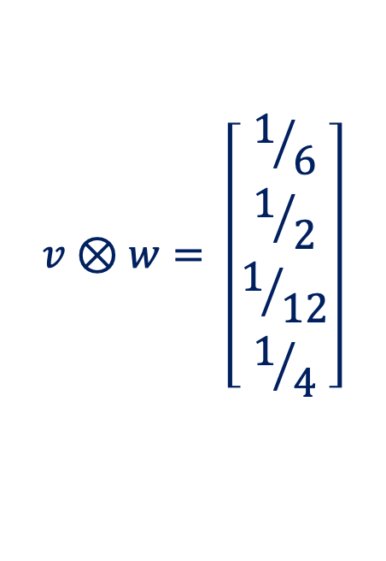
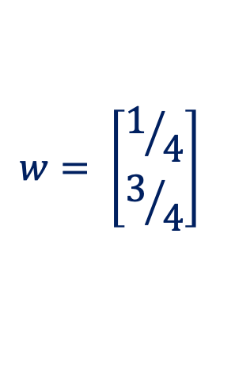

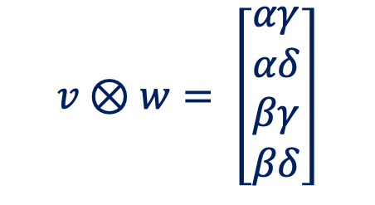
Primer On Tensor Product
$$v⊗w= \left[\begin{matrix}1/6 \\ \begin{aligned}1/2 \\ 1/{12} \\ 1/4\end{aligned}\end{matrix}\right]$$
Flipping 2 coins (v and w):
$$v= \left[\begin{matrix}2/3 \\ 1/3\end{matrix}\right]$$
$$w= \left[\begin{matrix}1/4 \\ 3/4\end{matrix}\right]$$
$$v⊗w= \left[\begin{matrix}αγ \\ \begin{aligned}αδ \\ βγ \\ βδ\end{aligned}\end{matrix}\right]$$
Generalized representation of two qubits
(in superposition)
$$v= \left[\begin{matrix}α \\ β\end{matrix}\right]$$
$$w= \left[\begin{matrix}γ \\ δ\end{matrix}\right]$$
How do we use tensor products in the context of quantum operations?

Slide 11
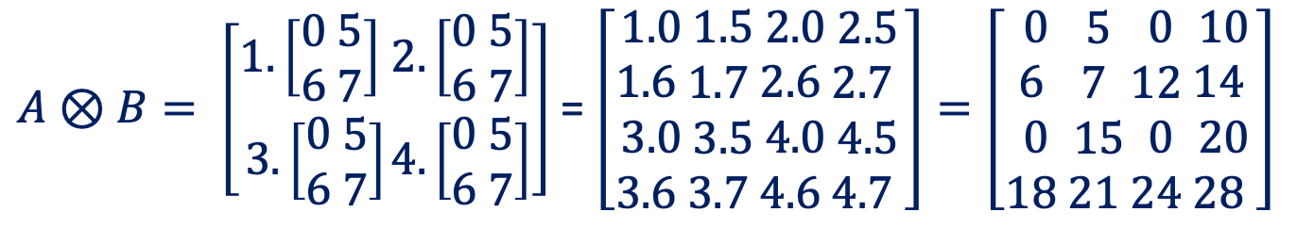
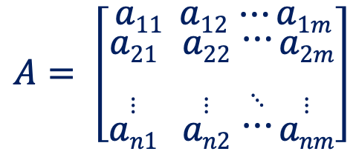
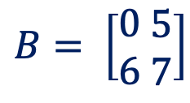
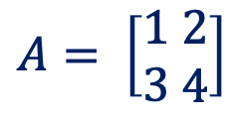
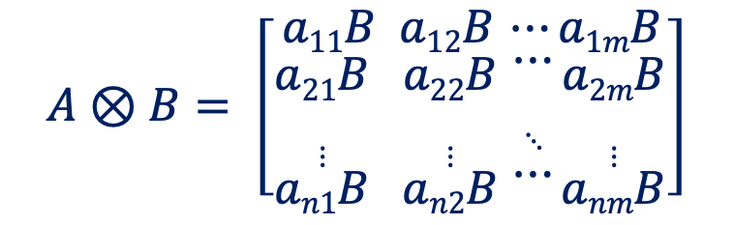
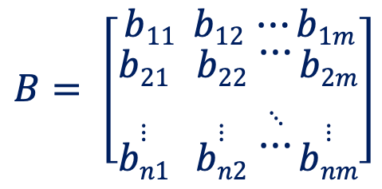
Tensor (Kronecker) Product
$$A= \left[\begin{matrix}a11 \\ \begin{aligned}a21 \\ ⋮ \\ an1\end{aligned} \end{matrix} \begin{matrix}a12 \\ \begin{aligned}a22 \\ ⋮ \\ an2\end{aligned}\end{matrix} \begin{matrix}⋯ \\ \begin{aligned}⋯ \\ ⋱ \\ ⋯\end{aligned}\end{matrix}\begin{matrix}a1m \\ \begin{aligned}a2m \\ ⋮ \\ anm\end{aligned}\end{matrix}\right]$$
$$B= \left[\begin{matrix}b11 \\ \begin{aligned}b21 \\ ⋮ \\ bn1\end{aligned} \end{matrix} \begin{matrix}b12 \\ \begin{aligned}b22 \\ ⋮ \\ bn2\end{aligned}\end{matrix} \begin{matrix}⋯ \\ \begin{aligned}⋯ \\ ⋱ \\ ⋯\end{aligned}\end{matrix}\begin{matrix}b1m \\ \begin{aligned}b2m \\ ⋮ \\ bnm\end{aligned}\end{matrix}\right]$$
$$A⊗B= \left[\begin{matrix}a11B \\ \begin{aligned}a21B \\ ⋮ \\ an1B\end{aligned} \end{matrix} \begin{matrix}a12B \\ \begin{aligned}a22B \\ ⋮ \\ an2B\end{aligned}\end{matrix} \begin{matrix}⋯ \\ \begin{aligned}⋯ \\ ⋱ \\ ⋯\end{aligned}\end{matrix}\begin{matrix}a1mB \\ \begin{aligned}a2mB \\ ⋮ \\ anmB\end{aligned}\end{matrix}\right]$$
Example:
$A⊗B= \left[\begin{aligned}1.\left[\begin{aligned}0 \\ 6\end{aligned} \begin{matrix}5 \\ 7\end{matrix}\right] \\ 3.\left[\begin{aligned}0 \\ 6\end{aligned} \begin{matrix}5 \\ 7\end{matrix}\right]\end{aligned}\begin{matrix}2.\left[\begin{aligned}0 \\ 6\end{aligned} \begin{matrix}5 \\ 7\end{matrix}\right] \\ 4.\left[\begin{aligned}0 \\ 6\end{aligned} \begin{matrix}5 \\ 7\end{matrix}\right]\end{matrix}\right]$ = $\left[\begin{aligned}1.0 \\ 1.6 \\ 3.0 \\ 3.6 \end{aligned}\begin{aligned}1.5 \\ 1.7 \\ 3.5 \\ 3.7 \end{aligned}\begin{aligned}2.0 \\ 2.6 \\ 4.0 \\ 4.6 \end{aligned}\begin{aligned}2.5 \\ 2.7 \\ 4.5 \\ 4.7 \end{aligned}\right]=\left[\begin{aligned}0 \\ 6 \\ 0 \\ 18 \end{aligned}\begin{aligned}5 \\ 7 \\ 15 \\ 21 \end{aligned}\begin{aligned}0 \\ 12 \\ 0 \\ 24 \end{aligned}\begin{aligned}10 \\ 14 \\ 20 \\ 28 \end{aligned}\right]$
$$A= \left[\begin{aligned}1 \\ 3\end{aligned} \begin{matrix}2 \\ 4\end{matrix}\right]$$
$$B= \left[\begin{aligned}0 \\ 6\end{aligned} \begin{matrix}5 \\ 7\end{matrix}\right]$$
Tensor product describes the effect of two independent operations (even on entangled states)

Slide 12
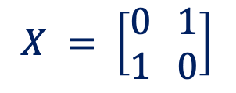
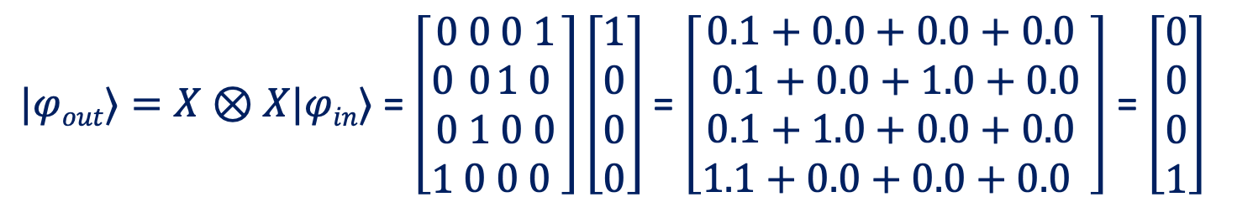
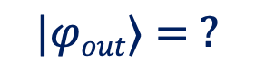
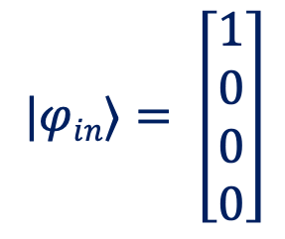
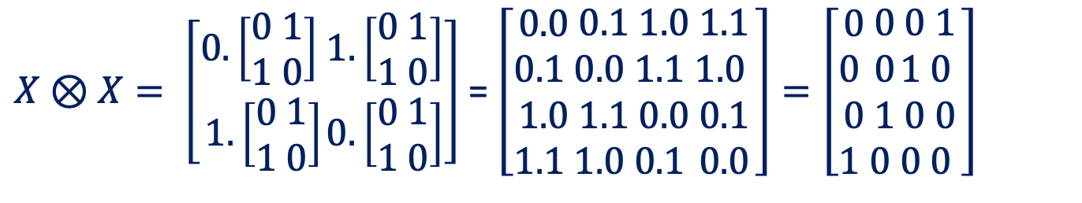
Describing Multiple Operations Using Tensor Products
q0
X
$X⊗X= \left[\begin{aligned}0.\left[\begin{aligned}0 \\ 1\end{aligned} \begin{matrix}1 \\ 0\end{matrix}\right] \\ 1.\left[\begin{aligned}0 \\ 1\end{aligned} \begin{matrix}1 \\ 0\end{matrix}\right]\end{aligned}\begin{matrix}1.\left[\begin{aligned}0 \\ 1\end{aligned} \begin{matrix}1 \\ 0\end{matrix}\right] \\ 0.\left[\begin{aligned}0 \\ 1\end{aligned} \begin{matrix}1 \\ 0\end{matrix}\right]\end{matrix}\right]$ = $\left[\begin{aligned}0.0 \\ 0.1 \\ 1.0 \\ 1.1 \end{aligned}\begin{aligned}0.1 \\ 0.0 \\ 1.1 \\ 1.0 \end{aligned}\begin{aligned}1.0 \\ 1.1 \\ 0.0 \\ 0.1 \end{aligned}\begin{aligned}1.1 \\ 1.0 \\ 0.1 \\ 0.0\end{aligned}\right]=\left[\begin{aligned}0 \\ 0 \\ 0 \\ 1 \end{aligned}\begin{aligned}0 \\ 0 \\ 1 \\ 0 \end{aligned}\begin{aligned}0 \\ 1 \\ 0 \\ 0 \end{aligned}\begin{aligned}1 \\ 0 \\ 0 \\ 0 \end{aligned}\right]$
q1
X
$$|φin⟩= \left[\begin{aligned}1 \\ 0 \\ 0 \\ 0\end{aligned}\right]$$
$$X = \left[\begin{matrix}0 \\ 1\end{matrix} \begin{matrix}1 \\ 0\end{matrix}\right]$$
$$|φout⟩= ?$$
$|φout⟩=X⊗X|φin⟩$ = $\left[\begin{aligned}0 \\ 0 \\ 0 \\ 1 \end{aligned}\begin{aligned}0 \\ 0 \\ 1 \\ 0 \end{aligned}\begin{aligned}0 \\ 1 \\ 0 \\ 0 \end{aligned}\begin{aligned}1 \\ 0 \\ 0 \\ 0 \end{aligned}\right]\left[\begin{aligned}1 \\ 0 \\ 0 \\ 0\end{aligned}\right]$ = $\left[\begin{aligned}0.1+0.0+0.0+0.0 \\ 0.1+0.0+1.0+0.0 \\ 0.1+1.0+0.0+0.0 \\ 1.1+0.0+0.0+0.0 \end{aligned}\right]$ = $\left[\begin{aligned}0 \\ 0 \\ 0 \\ 1\end{aligned}\right]$
Probability associated with state 11
Exercise: Can you compute the output state if X gates are replaced by H gates?

Slide 13
Multi-qubit Operations: Introduction To CNOT
Controlled NOT or CNOT is a two-qubit operation involving two qubits: control and target
The state of the target qubit changes depending on the state of the control qubit
When the state of the control qubit is 0, the target remains unchanged
When the state of the control qubit is 1, the target state flips from 0 to 1 or from 1 to 0
Initial (q0q1) | Final (q0q1)
|00⟩ | |00⟩
|01⟩ | |01⟩
|10⟩ | |11⟩
|11⟩ | |10⟩
Control
q0
Target
q1
+
Can we represent a CNOT using a matrix representation?

Slide 14
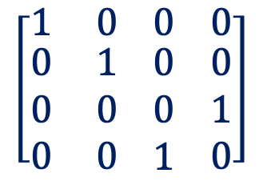
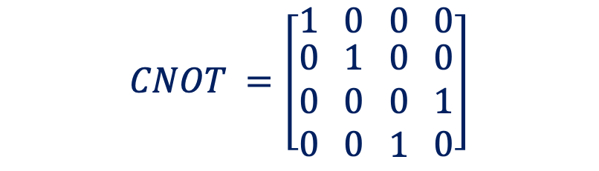
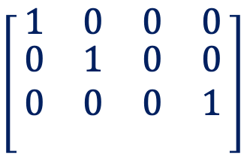
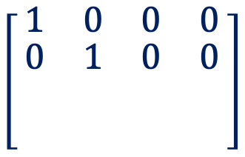


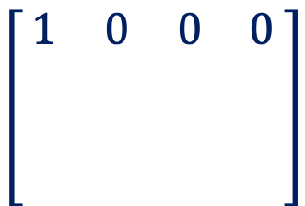
$$CNOT =\left[\begin{matrix}1 \\ \begin{aligned}0 \\ 0 \\ 0\end{aligned}\end{matrix} \begin{matrix}0 \\ \begin{aligned}1 \\ 0 \\ 0\end{aligned}\end{matrix} \begin{matrix}0 \\ \begin{aligned}0 \\ 0 \\ 1\end{aligned}\end{matrix} \begin{matrix}0 \\ \begin{aligned}0 \\ 1 \\ 0\end{aligned}\end{matrix}\right]$$
CNOT As A Matrix
Initial (q0q1) | Final (q0q1)
|00⟩ | |00⟩
|01⟩ | |01⟩
|10⟩ | |11⟩
|11⟩ | |10⟩
4 input states and 4 output states- 4x4 matrix
Row index corresponds to input state
Column index corresponds to output state
Entry[row][col] -> probability of obtaining the state corresponding to col if the state corresponding to row is the input
00
01
10
11
00
01
10
11
00
01
10
11
00
01
10
11
00
$$\left[\begin{matrix}1 \\ \begin{aligned} \\ \\ \end{aligned}\end{matrix} \begin{matrix}0 \\ \begin{aligned} \\ \\ \end{aligned}\end{matrix} \begin{matrix}0 \\ \begin{aligned} \\ \\ \end{aligned}\end{matrix} \begin{matrix}0 \\ \begin{aligned} \\ \\ \end{aligned}\end{matrix}\right]$$
00
$$\left[\begin{matrix}1 \\ \begin{aligned}0 \\ \\ \end{aligned}\end{matrix} \begin{matrix}0 \\ \begin{aligned}1 \\ \\ \end{aligned}\end{matrix} \begin{matrix}0 \\ \begin{aligned}0 \\ \\ \end{aligned}\end{matrix} \begin{matrix}0 \\ \begin{aligned}0 \\ \\ \end{aligned}\end{matrix}\right]$$
00
$$\left[\begin{matrix}1 \\ \begin{aligned}0 \\ 0 \\ \end{aligned}\end{matrix} \begin{matrix}0 \\ \begin{aligned}1 \\ 0 \\ \end{aligned}\end{matrix} \begin{matrix}0 \\ \begin{aligned}0 \\ 0 \\ \end{aligned}\end{matrix} \begin{matrix}0 \\ \begin{aligned}0 \\ 1 \\ \end{aligned}\end{matrix}\right]$$
00
$$\left[\begin{matrix}1 \\ \begin{aligned}0 \\ 0 \\ 0\end{aligned}\end{matrix} \begin{matrix}0 \\ \begin{aligned}1 \\ 0 \\ 0\end{aligned}\end{matrix} \begin{matrix}0 \\ \begin{aligned}0 \\ 0 \\ 1\end{aligned}\end{matrix} \begin{matrix}0 \\ \begin{aligned}0 \\ 1 \\ 0\end{aligned}\end{matrix}\right]$$
01
01
01
01
10
10
10
10
11
11
11
11
How to use this matrix notation?

Slide 15
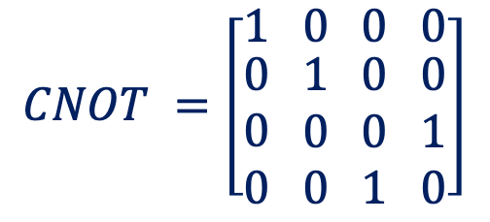
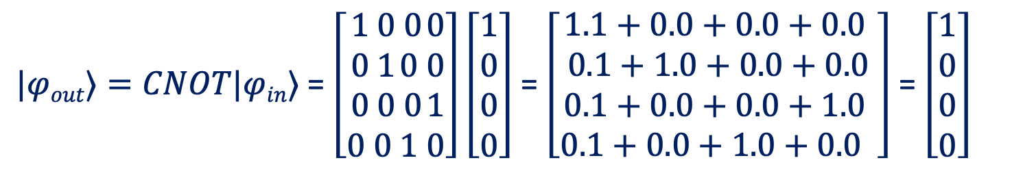
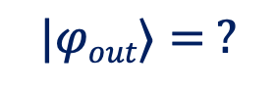
CNOT In Quantum Circuits
q0
q1
+
$$|φin⟩= \left[\begin{aligned}1 \\ 0 \\ 0 \\ 0\end{aligned}\right]$$
$$CNOT =\left[\begin{matrix}1 \\ \begin{aligned}0 \\ 0 \\ 0\end{aligned}\end{matrix} \begin{matrix}0 \\ \begin{aligned}1 \\ 0 \\ 0\end{aligned}\end{matrix} \begin{matrix}0 \\ \begin{aligned}0 \\ 0 \\ 1\end{aligned}\end{matrix} \begin{matrix}0 \\ \begin{aligned}0 \\ 1 \\ 0\end{aligned}\end{matrix}\right]$$
$$|φout⟩= ?$$
Probability associated with state 00
$|φout⟩=CNOT|φin⟩$ = $\left[\begin{aligned}1 \\ 0 \\ 0 \\ 0 \end{aligned}\begin{aligned}0 \\ 1 \\ 0 \\ 0 \end{aligned}\begin{aligned}0 \\ 0 \\ 0 \\ 1 \end{aligned}\begin{aligned}0 \\ 0 \\ 1 \\ 0\end{aligned}\right]\left[\begin{aligned}1 \\ 0 \\ 0 \\ 0\end{aligned}\right]$ = $\left[\begin{aligned}1.1+0.0+0.0+0.0 \\ 0.1+1.0+0.0+0.0 \\ 0.1+0.0+0.0+1.0 \\ 0.1+0.0+1.0+0.0 \end{aligned}\right]$ = $\left[\begin{aligned}1 \\ 0 \\ 0 \\ 0\end{aligned}\right]$
Exercise: Explain the bell pair circuit using the matrix representation

Slide 16

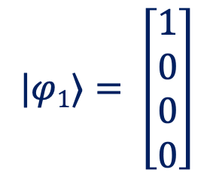
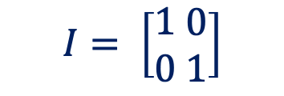
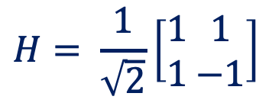

Bell-Pair Circuit Using Matrix Representation
1
2
3
4
$$H= \frac{1}{\sqrt{2}}\left[\begin{aligned}1 \\ 1\end{aligned} \begin{matrix}1 \\ −1\end{matrix}\right]$$
q0
H
M
q1
I
+
M
$$I= \left[\begin{aligned}1 \\ 0\end{aligned} \begin{matrix}0 \\ 1\end{matrix}\right]$$
$$|φ1⟩= \left[\begin{aligned}1 \\ 0 \\ 0 \\ 0\end{aligned}\right]$$
1
$H⊗I= \left[\begin{aligned}\frac{1}{\sqrt{2}}.\left[\begin{aligned}1 \\ 0\end{aligned} \begin{matrix}0 \\ 1\end{matrix}\right] \\ \frac{1}{\sqrt{2}}.\left[\begin{aligned}1 \\ 0\end{aligned} \begin{matrix}0 \\ 1\end{matrix}\right]\end{aligned} \begin{matrix}\frac{1}{\sqrt{2}}.\left[\begin{aligned}1 \\ 0\end{aligned} \begin{matrix}0 \\ 1\end{matrix}\right] \\ \frac{−1}{\sqrt{2}}.\left[\begin{aligned}1 \\ 0\end{aligned} \begin{matrix}0 \\ 1\end{matrix}\right]\end{matrix}\right]$ = $\left[\begin{aligned}\frac{1}{\sqrt{2}}.1 \\ \frac{1}{\sqrt{2}}.0 \\ \frac{1}{\sqrt{2}}.1 \\ \frac{1}{\sqrt{2}}.0 \end{aligned} \begin{aligned}\frac{1}{\sqrt{2}}.0 \\ \frac{1}{\sqrt{2}}.1 \\ \frac{1}{\sqrt{2}}.0 \\ \frac{1}{\sqrt{2}}.1 \end{aligned} \begin{aligned}\frac{1}{\sqrt{2}}.1 \\ \frac{1}{\sqrt{2}}.0 \\ \frac{−1}{\sqrt{2}}.1 \\ \frac{−1}{\sqrt{2}}.0\end{aligned} \begin{aligned}\frac{1}{\sqrt{2}}.0 \\ \frac{1}{\sqrt{2}}.1 \\ \frac{−1}{\sqrt{2}}.0 \\ \frac{−1}{\sqrt{2}}.1\end{aligned}\right]=\left[\begin{aligned}\frac{1}{\sqrt{2}} \\ 0 \\ \frac{1}{\sqrt{2}} \\ 0 \end{aligned} \begin{aligned}0 \\ \frac{1}{\sqrt{2}} \\ 0 \\ \frac{1}{\sqrt{2}}\end{aligned} \begin{aligned}\frac{1}{\sqrt{2}} \\ 0 \\ \frac{−1}{\sqrt{2}} \\ 0 \end{aligned} \begin{aligned}0 \\ \frac{1}{\sqrt{2}} \\ 0 \\ \frac{−1}{\sqrt{2}}\end{aligned}\right]$

Slide 17

Bell-Pair Circuit Using Matrix Representation
1
2
3
4
q0
H
M
q1
I
+
M
$\left|φ2\right\rangle =H⊗I\left|φ1\right\rangle =\left[\begin{aligned}\frac{1}{\sqrt{2}} \\ 0 \\ \frac{1}{\sqrt{2}} \\ 0 \end{aligned} \begin{aligned}0 \\ \frac{1}{\sqrt{2}} \\ 0 \\ \frac{1}{\sqrt{2}}\end{aligned} \begin{aligned}\frac{1}{\sqrt{2}} \\ 0 \\ \frac{−1}{\sqrt{2}} \\ 0 \end{aligned} \begin{aligned}0 \\ \frac{1}{\sqrt{2}} \\ 0 \\ \frac{−1}{\sqrt{2}}\end{aligned}\right]\left[\begin{aligned}1 \\ 0 \\ 0 \\ 0\end{aligned}\right]$ = $\left[\begin{aligned}\frac{1}{\sqrt{2}}.1+0.0+\frac{1}{\sqrt{2}}.0+0.0 \\ 0.1+\frac{1}{\sqrt{2}}.0+0.0+\frac{1}{\sqrt{2}}.0 \\ \frac{1}{\sqrt{2}}.1+0.0+\frac{−1}{\sqrt{2}}.0+0.0 \\ 0.1+\frac{1}{\sqrt{2}}.0+0.0+\frac{−1}{\sqrt{2}}.0\end{aligned}\right]=\left[\begin{aligned}\frac{1}{\sqrt{2}} \\ 0 \\ \frac{1}{\sqrt{2}} \\ 0\end{aligned}\right]$
1

Slide 18

Bell-Pair Circuit Using Matrix Representation
1
2
3
4
q0
H
M
q1
I
+
M
$\left|φ3\right\rangle =CNOT\left|φ2\right\rangle =\left[\begin{aligned}1 \\ 0 \\ 0 \\ 0\end{aligned} \begin{aligned}0 \\ 1 \\ 0 \\ 0\end{aligned} \begin{aligned}0 \\ 0 \\ 0 \\ 1\end{aligned} \begin{aligned}0 \\ 0 \\ 1 \\ 0\end{aligned}\right]\left[\begin{aligned}\frac{1}{\sqrt{2}} \\ 0 \\ \frac{1}{\sqrt{2}} \\ 0\end{aligned}\right]$ = $\left[\begin{aligned}1.\frac{1}{\sqrt{2}}+0.0+0.\frac{1}{\sqrt{2}}+0.0 \\ 0.\frac{1}{\sqrt{2}}+1.0+0.\frac{1}{\sqrt{2}}+0.0 \\ 0.\frac{1}{\sqrt{2}}+0.0+0.\frac{1}{\sqrt{2}}+1.0 \\ 0.\frac{1}{\sqrt{2}}+0.0+1.\frac{1}{\sqrt{2}}+0.0\end{aligned}\right]=\left[\begin{aligned}\frac{1}{\sqrt{2}} \\ 0 \\ 0 \\ \frac{1}{\sqrt{2}}\end{aligned}\right]$
1
Measurement produces 00 with 50% probability ($|\frac{1}{\sqrt{2}}$|² ) and 11 with 50% probability ( $|\frac{1}{\sqrt{2}}$|² )
How about explaining the same circuit using Dirac notation?

Slide 19

Bell-Pair Circuit Using Dirac Notation
1
2
3
4
q0
H
M
q1
+
M
1
$\left|00\right\rangle \underset{→}{H} \frac{1}{\sqrt{2}}$ $\left|00\right\rangle$ + $\frac{1}{\sqrt{2}}$ $\left|10\right\rangle$ $\underset{→}{CNOT} \frac{1}{\sqrt{2}}$ $\left|00\right\rangle$ + $\frac{1}{\sqrt{2}}$ $\left|11\right\rangle$
Terse Representation
What is the advantage of terse representation?

Slide 20




How To Test For Entanglement?
Let $\left|∅\right\rangle$be the combined state of a two-qubit system
If $\left|∅\right\rangle$ can be decomposed into two quantum states $\left|ψ1\right\rangle$ and $\left|ψ2\right\rangle$ such that $\left|ψ1\right\rangle ⊗\left|ψ2\right\rangle =\left|∅\right\rangle$, then the two qubits are entangled
Generalization:
1
Not Entangled (separable) $\left|ψ1\right\rangle$= $\left|ψ2\right\rangle$
If we denote a state $\left|Ψ\right\rangle$
$\left|Ψ\right\rangle = α\left|0\right\rangle$ $⊗$ $\left|ψ1\right\rangle$+ $β\left|1\right\rangle ⊗$ $\left|ψ2\right\rangle$
Entangled (not separable) $\left|ψ1\right\rangle ≠\left|ψ2\right\rangle$
q0
H
q1
H
Exercise: Is the Bell Pair State an entangled state?

Slide 21

Classroom Example: Create State & Test If Entangled
q0
H
q1
H
$H⊗H= \left[\begin{aligned}\frac{1}{\sqrt{2}}.\left[\begin{aligned}\frac{1}{\sqrt{2}} \\ \frac{1}{\sqrt{2}}\end{aligned} \begin{matrix}\frac{1}{\sqrt{2}} \\ \frac{−1}{\sqrt{2}}\end{matrix}\right] \\ \frac{1}{\sqrt{2}}.\left[\begin{aligned}\frac{1}{\sqrt{2}} \\ \frac{1}{\sqrt{2}}\end{aligned} \begin{matrix}\frac{1}{\sqrt{2}} \\ \frac{−1}{\sqrt{2}}\end{matrix}\right]\end{aligned} \begin{matrix}\frac{1}{\sqrt{2}}.\left[\begin{aligned}\frac{1}{\sqrt{2}} \\ \frac{1}{\sqrt{2}}\end{aligned} \begin{matrix}\frac{1}{\sqrt{2}} \\ \frac{−1}{\sqrt{2}}\end{matrix}\right] \\ \frac{−1}{\sqrt{2}}.\left[\begin{aligned}\frac{1}{\sqrt{2}} \\ \frac{1}{\sqrt{2}}\end{aligned} \begin{matrix}\frac{1}{\sqrt{2}} \\ \frac{−1}{\sqrt{2}}\end{matrix}\right]\end{matrix}\right]$ = $\left[\begin{aligned}\frac{1}{\sqrt{2}}.\frac{1}{\sqrt{2}} \\ \frac{1}{\sqrt{2}}.\frac{1}{\sqrt{2}} \\ \frac{1}{\sqrt{2}}.\frac{1}{\sqrt{2}} \\ \frac{1}{\sqrt{2}}.\frac{1}{\sqrt{2}}\end{aligned} \begin{aligned}\frac{1}{\sqrt{2}}.\frac{1}{\sqrt{2}} \\ \frac{1}{\sqrt{2}}.\frac{−1}{\sqrt{2}} \\ \frac{1}{\sqrt{2}}.\frac{1}{\sqrt{2}} \\ \frac{1}{\sqrt{2}}.\frac{−1}{\sqrt{2}}\end{aligned} \begin{aligned}\frac{1}{\sqrt{2}}.\frac{1}{\sqrt{2}} \\ \frac{1}{\sqrt{2}}.\frac{1}{\sqrt{2}} \\ \frac{−1}{\sqrt{2}}.\frac{1}{\sqrt{2}} \\ \frac{−1}{\sqrt{2}}.\frac{1}{\sqrt{2}}\end{aligned} \begin{aligned}\frac{1}{\sqrt{2}}.\frac{1}{\sqrt{2}} \\ \frac{1}{\sqrt{2}}.\frac{−1}{\sqrt{2}} \\ \frac{−1}{\sqrt{2}}.\frac{1}{\sqrt{2}} \\ \frac{−1}{\sqrt{2}}.\frac{−1}{\sqrt{2}}\end{aligned}\right]=\left[\begin{aligned}\frac{1}{2} \\ \frac{1}{2} \\ \frac{1}{2} \\ \frac{1}{2}\end{aligned} \begin{aligned}\frac{1}{2} \\ \frac{−1}{2} \\ \frac{1}{2} \\ \frac{−1}{2}\end{aligned} \begin{aligned}\frac{1}{2} \\ \frac{1}{2} \\ \frac{−1}{2} \\ \frac{−1}{2} \end{aligned} \begin{aligned}\frac{1}{2} \\ \frac{−1}{2} \\ \frac{−1}{2} \\ \frac{1}{2}\end{aligned}\right]$

Slide 22




Classroom Example: Create State & Test If Entangled
q0
H
q1
H
$|φout⟩=H⊗H|φin⟩$ = $\left[\begin{aligned}\frac{1}{2} \\ \frac{1}{2} \\ \frac{1}{2} \\ \frac{1}{2}\end{aligned} \begin{aligned}\frac{1}{2} \\ \frac{−1}{2} \\ \frac{1}{2} \\ \frac{−1}{2}\end{aligned} \begin{aligned}\frac{1}{2} \\ \frac{1}{2} \\ \frac{−1}{2} \\ \frac{−1}{2} \end{aligned} \begin{aligned}\frac{1}{2} \\ \frac{−1}{2} \\ \frac{−1}{2} \\ \frac{1}{2}\end{aligned}\right]\left[\begin{aligned}1 \\ 0 \\ 0 \\ 0\end{aligned}\right]$ = $\left[\begin{aligned}\frac{1}{2}.1+\frac{1}{2}.0+\frac{1}{2}.0+\frac{1}{2}.0 \\ \frac{1}{2}.1+\frac{−1}{2}.0+\frac{1}{2}.0+\frac{−1}{2}.0 \\ \frac{1}{2}.1+\frac{1}{2}.0+\frac{−1}{2}.0+\frac{−1}{2}.0 \\ \frac{1}{2}.1+\frac{−1}{2}.0+\frac{−1}{2}.0+\frac{1}{2}.0 \end{aligned}\right]$ = $\left[\begin{aligned}\frac{1}{2} \\ \frac{1}{2} \\ \frac{1}{2} \\ \frac{1}{2}\end{aligned}\right]$
$\left|φout\right\rangle =\frac{1}{2}$ ( $\left|00\right\rangle$ +$\left|01\right\rangle +\left|10\right\rangle +\left|11\right\rangle$ )
= $\frac{1}{\sqrt{2}} \left|0\right\rangle ⊗(\left|0\right\rangle +\left|1\right\rangle )$ + $\frac{1}{\sqrt{2}} \left|1\right\rangle ⊗(\left|0\right\rangle +\left|1\right\rangle )$
$$|φ1⟩$$
$$|φ2⟩$$

Slide 23









No Cloning Theorem
Let $\left|ψ\right\rangle A$be the arbitrary state of a qubit ‘A’, $\left|0\right\rangle B$be the state of another qubit ‘B’
Is there a Unitary U_{clone} that copies the state of qubit ‘A’ into qubit ‘B’ such that $\left|ψ\right\rangle A$ = $\left|ψ\right\rangle B$?
Proof:
$$\left|ψ\right\rangle A$$
U_{clone}
$$\left|ψ\right\rangle A$$
$(α\left|0\right\rangle$ + $β$ $\left|1\right\rangle )\left|0\right\rangle \underset{→}{Uclone}α\left|00\right\rangle \text{ + }β \left|11\right\rangle$
$$\left|0\right\rangle B$$
$$\left|ψ\right\rangle B$$
$(\left|ψ\right\rangle ⊗|ψ⟩)=(α|0⟩+ β|1⟩)⊗$ $(α|0⟩+ β|1⟩)$
$=α$² $\left|00\right\rangle + αβ\left|01\right\rangle + αβ\left|10\right\rangle + β2\left|11\right\rangle$
$$Uclone (\left|ψ\right\rangle ⊗|0⟩) →(\left|ψ\right\rangle ⊗|ψ⟩)$$
$$αβ= 0$$
$α=α$²
$β=β$²
Quantum states cannot be cloned (qubits cannot be copied)

Slide 24




Quantum Teleportation
Copying a quantum state is not allowed, but destroying and regenerating a state is allowed
$$\left|ψ\right\rangle$$
Alice
1
Generates an EPR pair, sends on qubit to Bob
Allows her qubit $\left|ψ\right\rangle$ to interact with her qubit from the EPR pair (that she retained)
Measures both the qubits and transmits the classical information
2
Bob
3
4
Uses the classical information to ‘fixup’ his qubit
Quantum teleportation works even if Alice and Bob are on different planets! (conditions apply)

Slide 25







$$\left|ψ\right\rangle A$$
Understanding Quantum Teleportation
$$α\left|0\right\rangle +β\left|1\right\rangle$$
Alice
$$\left|ψ\right\rangle$$
H
M
Alice
$$\left|0\right\rangle$$
H
+
M
Alice
$$\left|0\right\rangle$$
+
X
Z
Bob
1
$$\frac{\left|00\right\rangle +\left|11\right\rangle }{\sqrt{2}}$$
$$(α\left|0\right\rangle +β\left|1\right\rangle )\frac{\left|00\right\rangle +\left|11\right\rangle }{\sqrt{2}}= \frac{α\left|000\right\rangle +α\left|011\right\rangle +β\left|100\right\rangle + β\left|111\right\rangle }{\sqrt{2}}$$

Slide 26



$$\left|ψ\right\rangle A$$
Understanding Quantum Teleportation
2
Alice
$$\left|ψ\right\rangle$$
H
M
Alice
$$\left|0\right\rangle$$
H
+
M
$$\left|0\right\rangle$$
+
X
Z
Bob
$$\frac{α\left|000\right\rangle +α\left|011\right\rangle +β\left|100\right\rangle + β\left|111\right\rangle }{\sqrt{2}}$$
$$\frac{α\left|000\right\rangle +α\left|011\right\rangle +β\left|110\right\rangle + β\left|101\right\rangle }{\sqrt{2}}$$

Slide 27


$$\left|ψ\right\rangle A$$
Understanding Quantum Teleportation
Alice
$$\left|ψ\right\rangle$$
H
M
Alice
$$\left|0\right\rangle$$
H
+
M
$$\left|0\right\rangle$$
+
X
Z
Bob
$$\frac{α\left|000\right\rangle +α\left|011\right\rangle +β\left|110\right\rangle + β\left|101\right\rangle }{\sqrt{2}}$$
$$\frac{α(\frac{\left|0\right\rangle +\left|1\right\rangle }{\sqrt{2}})\left|00\right\rangle +α(\frac{\left|0\right\rangle +\left|1\right\rangle }{\sqrt{2}})\left|11\right\rangle +β(\frac{\left|0\right\rangle −\left|1\right\rangle }{\sqrt{2}})\left|10\right\rangle + β(\frac{\left|0\right\rangle −\left|1\right\rangle }{\sqrt{2}})\left|01\right\rangle }{\sqrt{2}}$$
$$\frac{1}{2}\left[α\left|000\right\rangle +α\left|100\right\rangle +α\left|011\right\rangle +α\left|111\right\rangle +β\left|010\right\rangle −β\left|110\right\rangle + β\left|001\right\rangle −β\left|101\right\rangle \right]$$
$$\frac{1}{2}\left[\left|00\right\rangle \left(α\left|0\right\rangle +β\left|1\right\rangle \right)+\left|01\right\rangle \left(α\left|1\right\rangle +β\left|0\right\rangle \right)+\left|10\right\rangle (α\left|0\right\rangle −β\left|1\right\rangle )+\left|11\right\rangle (α\left|1\right\rangle −β\left|0\right\rangle )\right]$$

Slide 28


$$\left|ψ\right\rangle A$$
Understanding Quantum Teleportation
3
4
Alice
$$\left|ψ\right\rangle$$
H
M
Alice
$$\left|0\right\rangle$$
H
+
M
$$\left|0\right\rangle$$
+
X
Z
Bob
$$\frac{1}{2}\left[\left|00\right\rangle \left(α\left|0\right\rangle +β\left|1\right\rangle \right)+\left|01\right\rangle \left(α\left|1\right\rangle +β\left|0\right\rangle \right)+\left|10\right\rangle (α\left|0\right\rangle −β\left|1\right\rangle )+\left|11\right\rangle (α\left|1\right\rangle −β\left|0\right\rangle )\right]$$
Case-1: Measurement outcome is 00
$$α\left|0\right\rangle +β\left|1\right\rangle$$
Do Nothing
‘0’ is the control for Controlled-X
‘0’ is the control for Controlled-Z
$$α\left|0\right\rangle +β\left|1\right\rangle$$

Slide 29

$$\left|ψ\right\rangle A$$
Understanding Quantum Teleportation
Alice
$$\left|ψ\right\rangle$$
H
M
Alice
$$\left|0\right\rangle$$
H
+
M
$$\left|0\right\rangle$$
+
X
Z
Bob
$$\frac{1}{2}\left[\left|00\right\rangle \left(α\left|0\right\rangle +β\left|1\right\rangle \right)+\left|01\right\rangle \left(α\left|1\right\rangle +β\left|0\right\rangle \right)+\left|10\right\rangle (α\left|0\right\rangle −β\left|1\right\rangle )+\left|11\right\rangle (α\left|1\right\rangle −β\left|0\right\rangle )\right]$$
Case-2: Measurement outcome is 01
$$α\left|1\right\rangle +β\left|0\right\rangle$$
Apply X
‘1’ is the control for Controlled-X
‘0’ is the control for Controlled-Z
$$α\left|0\right\rangle +β\left|1\right\rangle$$

Slide 30

$$\left|ψ\right\rangle A$$
Understanding Quantum Teleportation
Alice
$$\left|ψ\right\rangle$$
H
M
Alice
$$\left|0\right\rangle$$
H
+
M
$$\left|0\right\rangle$$
+
X
Z
Bob
$$\frac{1}{2}\left[\left|00\right\rangle \left(α\left|0\right\rangle +β\left|1\right\rangle \right)+\left|01\right\rangle \left(α\left|1\right\rangle +β\left|0\right\rangle \right)+\left|10\right\rangle (α\left|0\right\rangle −β\left|1\right\rangle )+\left|11\right\rangle (α\left|1\right\rangle −β\left|0\right\rangle )\right]$$
Case-3: Measurement outcome is 10
$$α\left|0\right\rangle −β\left|1\right\rangle$$
Apply Z
‘0’ is the control for Controlled-X
‘1’ is the control for Controlled-Z
$$α\left|0\right\rangle +β\left|1\right\rangle$$

Slide 31

$$\left|ψ\right\rangle A$$
Understanding Quantum Teleportation
Alice
$$\left|ψ\right\rangle$$
H
M
Alice
$$\left|0\right\rangle$$
H
+
M
$$\left|0\right\rangle$$
+
X
Z
Bob
$$\frac{1}{2}\left[\left|00\right\rangle \left(α\left|0\right\rangle +β\left|1\right\rangle \right)+\left|01\right\rangle \left(α\left|1\right\rangle +β\left|0\right\rangle \right)+\left|10\right\rangle (α\left|0\right\rangle −β\left|1\right\rangle )+\left|11\right\rangle (α\left|1\right\rangle −β\left|0\right\rangle )\right]$$
Case-4: Measurement outcome is 11
$$α\left|1\right\rangle −β\left|0\right\rangle$$
Apply X and Z
‘1’ is the control for Controlled-X
‘1’ is the control for Controlled-Z
$$α\left|0\right\rangle +β\left|1\right\rangle$$

Slide 32

$$\left|ψ\right\rangle A$$
Superdense Coding
Quite the opposite of quantum teleportation
In quantum teleportation, a qubit is sent by transmitting two classical bits
In superdense coding, sender can transmit two classical bits using one qubit *
00, 01, 10, 11
Charlie
Alice
Bob
Transmit more classical bits (securely) using fewer quantum bits

Slide 33









$$\left|ψ\right\rangle A$$
Understanding Superdense Coding
$$b1$$
$\frac{1}{\sqrt{2}} (\left|0A0B\right\rangle +\left|1A1B\right\rangle$)
$$b0$$
$$Qubit A$$
X
Z
Alice
Case-1: Alice wants to send ‘00’
Apply I
$\frac{1}{\sqrt{2}} (\left|0A0B\right\rangle +\left|1A1B\right\rangle$)
Case-2: Alice wants to send ‘01’
Apply X
$\frac{1}{\sqrt{2}} (\left|1A0B\right\rangle +\left|0A1B\right\rangle$)
Case-3: Alice wants to send ‘10’
Apply Z
$\frac{1}{\sqrt{2}} (\left|0A0B\right\rangle −\left|1A1B\right\rangle$)
Bob
Case-3: Alice wants to send ‘11’
Apply ZX
$\frac{1}{\sqrt{2}} (−\left|1A0B\right\rangle +\left|0A1B\right\rangle$)
$$Qubit B$$

Slide 34



















$$\left|ψ\right\rangle A$$
Understanding Superdense Coding
$$Qubit A$$
H
M
$$Qubit B$$
+
M
Bob
$$Qubit A$$
$$Qubit B$$
$\frac{1}{\sqrt{2}} (\left|0A0B\right\rangle +\left|1A1B\right\rangle$)
$\frac{1}{\sqrt{2}} (\left|0A0B\right\rangle +\left|1A0B\right\rangle$) = $\left|0B\right\rangle \frac{1}{\sqrt{2}} (\left|0A\right\rangle +\left|1A\right\rangle$)
$$\left|0A0B\right\rangle$$
$$00$$
$\frac{1}{\sqrt{2}} (\left|1A0B\right\rangle +\left|0A1B\right\rangle$)
$\frac{1}{\sqrt{2}} (\left|1A1B\right\rangle +\left|0A1B\right\rangle$) = $\left|1B\right\rangle \frac{1}{\sqrt{2}} (\left|0A\right\rangle +\left|1A\right\rangle$)
$$\left|0A1B\right\rangle$$
$$01$$
$\frac{1}{\sqrt{2}} (\left|0A0B\right\rangle −\left|1A1B\right\rangle$)
$\frac{1}{\sqrt{2}} (\left|0A0B\right\rangle −\left|1A0B\right\rangle$) = $\left|0B\right\rangle \frac{1}{\sqrt{2}} (\left|0A\right\rangle −\left|1A\right\rangle$)
$$\left|1A0B\right\rangle$$
$$10$$
$\frac{1}{\sqrt{2}} (−\left|1A0B\right\rangle +\left|0A1B\right\rangle$)
$\frac{1}{\sqrt{2}} (−\left|1A1B\right\rangle +\left|0A1B\right\rangle$) = $\left|1B\right\rangle \frac{1}{\sqrt{2}} (\left|0A\right\rangle −\left|1A\right\rangle$)
$$\left|1A1B\right\rangle$$
$$11$$
Notes:
Security Aspect [note that this protocol was developed in 1992]
Superdense Coding, along with Quantum Teleportation, is the underlying principle of secure quantum coding since it eliminates the possibility of eavesdroppers intercepting messages.
Let’s say an eavesdropper named Eve intercepted Alice’s encoded qubit en route to Bob. Eve would only have 1/2 of an entangled state and without access to Bob’s qubit (which is necessary to decode Alice’s qubit), Eve would have no way of getting the information from Alices qubit. Furthermore, any attempt to measure either Alice’s or Bob’s qubit would collapse the state of said qubit and alert both of them.

Slide 35









$$\left|ψ\right\rangle A$$
Other Single-Qubit Gates
Generalized Single Qubit Rotation
Rotation by $θ$ about the $\hat{n}$ axis
$$RX(θ)= \left[\begin{aligned}\cos{\frac{θ}{2}} \\ −i\sin{\frac{θ}{2}}\end{aligned} \begin{matrix}−i\sin{\frac{θ}{2}} \\ \cos{\frac{θ}{2}}\end{matrix}\right]$$
$$RY(θ)=\left[\begin{aligned}\cos{\frac{θ}{2}} \\ \sin{\frac{θ}{2}}\end{aligned} \begin{matrix}−\sin{\frac{θ}{2}} \\ \cos{\frac{θ}{2}}\end{matrix}\right]$$
$$RZ(θ)=\left[\begin{aligned}e^{−i\frac{θ}{2}} \\ 0\end{aligned} \begin{matrix}0 \\ e^{i\frac{θ}{2}}\end{matrix}\right]$$
Rotation by $\frac{π}{2}$ about the Z axis
Also called phase gate as it induces a phase
S Gate
$$S= \left[\begin{aligned}1 \\ 0\end{aligned} \begin{matrix}0 \\ −i\end{matrix}\right]$$
T Gate
$$T= \left[\begin{aligned}1 \\ 0\end{aligned} \begin{matrix}0 \\ e^{i\frac{θ}{4}}\end{matrix}\right]$$
Rotation by $\frac{π}{4}$ about the Z axis

Slide 36



$$\left|ψ\right\rangle A$$
Other Two-Qubit Gates
$$CX =\left[\begin{matrix}1 \\ \begin{aligned}0 \\ 0 \\ 0\end{aligned}\end{matrix} \begin{matrix}0 \\ \begin{aligned}1 \\ 0 \\ 0\end{aligned}\end{matrix} \begin{matrix}0 \\ \begin{aligned}0 \\ 0 \\ 1\end{aligned}\end{matrix} \begin{matrix}0 \\ \begin{aligned}0 \\ 1 \\ 0\end{aligned}\end{matrix}\right]$$
Flip the target qubit when the control qubit is in state |1⟩
+
X
CNOT
CX
Apply Y gate to the target qubit when the control qubit is in state |1⟩
$$CY =\left[\begin{matrix}1 \\ \begin{aligned}0 \\ 0 \\ 0\end{aligned}\end{matrix} \begin{matrix}0 \\ \begin{aligned}1 \\ 0 \\ 0\end{aligned}\end{matrix} \begin{matrix}0 \\ \begin{aligned}0 \\ 0 \\ i\end{aligned}\end{matrix} \begin{matrix}0 \\ \begin{aligned}0 \\ −i \\ 0\end{aligned}\end{matrix}\right]$$
Y
CY
$$CZ =\left[\begin{matrix}1 \\ \begin{aligned}0 \\ 0 \\ 0\end{aligned}\end{matrix} \begin{matrix}0 \\ \begin{aligned}0 \\ 0 \\ i\end{aligned}\end{matrix} \begin{matrix}0 \\ \begin{aligned}0 \\ 1 \\ 0\end{aligned}\end{matrix} \begin{matrix}0 \\ \begin{aligned}−i \\ 0 \\ 0\end{aligned}\end{matrix}\right]$$
Apply Z gate to the target qubit when the control qubit is in state |1⟩
Z
CZ

Slide 37

$$\left|ψ\right\rangle A$$
SWAP Gate
$$SWAP =\left[\begin{matrix}1 \\ \begin{aligned}0 \\ 0 \\ 0\end{aligned}\end{matrix} \begin{matrix}0 \\ \begin{aligned}0 \\ 1 \\ 0\end{aligned}\end{matrix} \begin{matrix}0 \\ \begin{aligned}1 \\ 0 \\ 0\end{aligned}\end{matrix} \begin{matrix}0 \\ \begin{aligned}0 \\ 0 \\ 1\end{aligned}\end{matrix}\right]$$
Interchange the state of two qubits
SWAP
+
+
+
+
+
Sequence of 3 CNOTs
Sequence of 2 CNOTs
SWAP gates are useful to relocate qubits

Slide 38
$$CNOT =\left[\begin{matrix}1 \\ \begin{aligned}0 \\ 0 \\ 0\end{aligned}\end{matrix} \begin{matrix}0 \\ \begin{aligned}1 \\ 0 \\ 0\end{aligned}\end{matrix} \begin{matrix}0 \\ \begin{aligned}0 \\ 0 \\ 1\end{aligned}\end{matrix} \begin{matrix}0 \\ \begin{aligned}0 \\ 1 \\ 0\end{aligned}\end{matrix}\right]$$
Toffoli Gate
q0
Initial (q0q1q2) | Final (q0q1q2)
|000⟩ | |000⟩
|001⟩ | |001⟩
|010⟩ | |010⟩
|011⟩ | |011⟩
|100⟩ | |100⟩
|101⟩ | |101⟩
|110⟩ | |111⟩
|111⟩ | |110⟩
Control-1
Control-2
q1
Flip the target qubit when both the control qubits are in state |1⟩
Target
q2
X
CCX
The Toffoli gate is an example of a three-qubit gate

Slide 39
$$CNOT =\left[\begin{matrix}1 \\ \begin{aligned}0 \\ 0 \\ 0\end{aligned}\end{matrix} \begin{matrix}0 \\ \begin{aligned}1 \\ 0 \\ 0\end{aligned}\end{matrix} \begin{matrix}0 \\ \begin{aligned}0 \\ 0 \\ 1\end{aligned}\end{matrix} \begin{matrix}0 \\ \begin{aligned}0 \\ 1 \\ 0\end{aligned}\end{matrix}\right]$$
On The Hardness Of Quantum Operations
Not all quantum operations are hard
Clifford Gates: Easy to simulate on classical systems [Example: H, CNOT, S]
Non-Clifford Gates: Makes quantum algorithms efficient and makes it harder to simulate quantum programs on conventional systems [Example: T]
Universal quantum gate set: Minimum set of gates that can be used to implement any quantum algorithm
In other words, it is possible to any other unitary operation can be expressed as a finite sequence of gates from the set.
Classical analogy: NAND gates can be used to implement any logic
Clifford gate + one Non-Clifford gate (T) = Universal gate set [H, CNOT, S, T]
Gottesman-Knill Theorem
Non-Clifford gates are the source of quantum-easy, classical-hard feature in quantum algorithms

